Slide 1
My mousetrap car
Inquiry Project
by Jocelyn Wells

Slide 2
Starting Questions
What should I use for wheels and axles?
How long should the lever arm be?
Should I try to make the car as light as possible?
What could I do to increase traction?
Would it be better to build a car for distance or for speed?
Notes:
Asking questions and Defining problems is Practice 1 from the Framework for K-12 Science Education. One of my biggest breakthroughs in this course has been realizing the power of having students develop their own questions. I have been working on having my students explore particular concepts by designing their own investigations, but this is an area where I really need to let go more. Students will be much more engaged and motivated to find the solutions to their own questions. Having the students generate their own questions is really the first step in the 5E Learning Cycle.

Slide 3
Goal
to build a mousetrap car that could travel 5m with the greatest average velocity possible
Notes:
After some deliberation and research online, I decided to build my mousetrap car for speed. I noticed that a few of the distance cars online were going much farther than I have the space (level) to test a car for distance. Even the hallways of my school (while empty in the summertime) turn, with not many long straight sections.

Slide 4
Initial tips from research
Use small wheels and a large axle so that the wheel to axle ratio is small
Maximize the string to axle traction
Build a lighter car for best speed as inertia will be smaller
Try to have energy released quickly with a shorter lever arm to travel a short distance quickly
Minimize friction by minimizing contact surface area
Notes:
After spending some time researching the success and failures of others who had gone before me I collected these tips which I tried to consider as my project evolved.

Slide 5
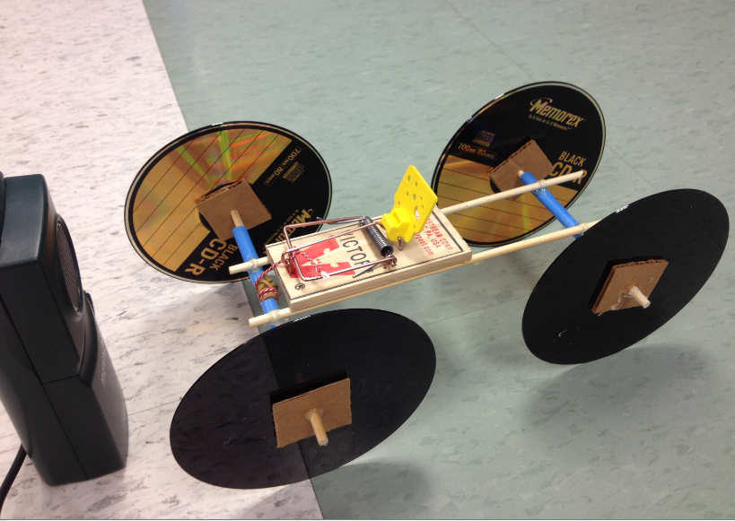
Car A
Notes:
This is the result of my first efforts. The axles are wooden skewers with cardboard and CD’s as the wheels. The mousetrap is resting on two more skewers which are attached to the blue straws in which the axles rotate.

Slide 6
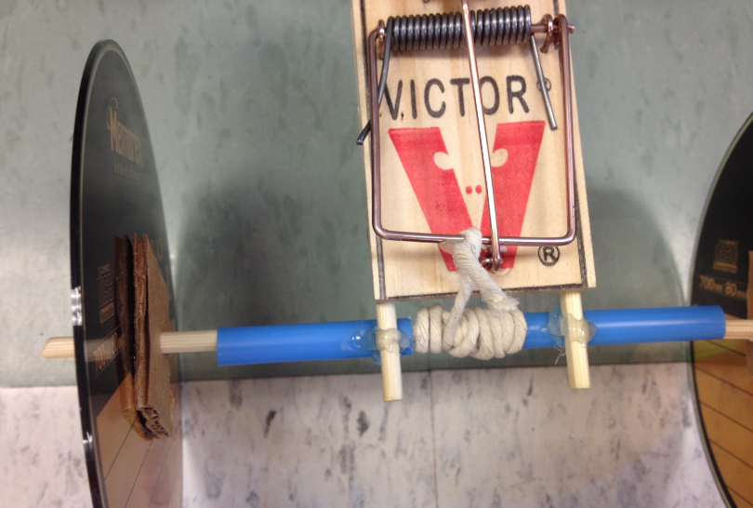
Car A showing axle detail
Notes:
In this picture you can see how the string is wound around the wooden skewer between the blue straw pieces.

Slide 7
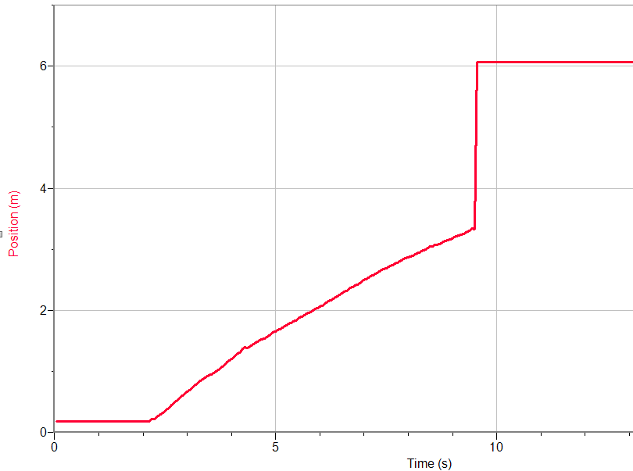
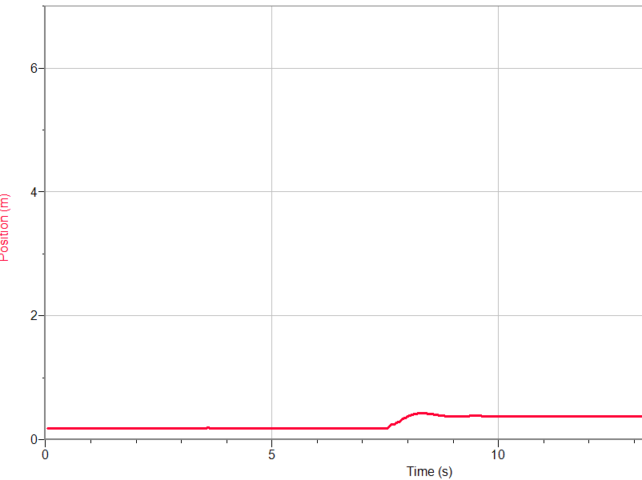
Position-time graphs for first set of trials with a lever arm of 8cm
Trial 1
Trial 2
Notes:
These first several trials I had some problems with the motion sensor losing track of the car (trial 1), or the string on the axle getting caught or not releasing properly (trial 2) It took me a few more trials before I discovered what the problems were and make adjustments to the experimental setup or car. I believe that an interesting question for students could be based on the position-time graphs of these first three or four trials. After some content relating to position-time graphs has been studied, these graphs could be given and combined with information regarding the car and the video. You can see from the video for trial three that the car goes farther than 3m and I would ask the students for possible reasons why the graph looks the way it does. A similar question could be posed while looking at the graphs for trial two and trial 4 without watching the video first.

Slide 8
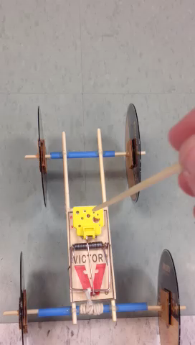
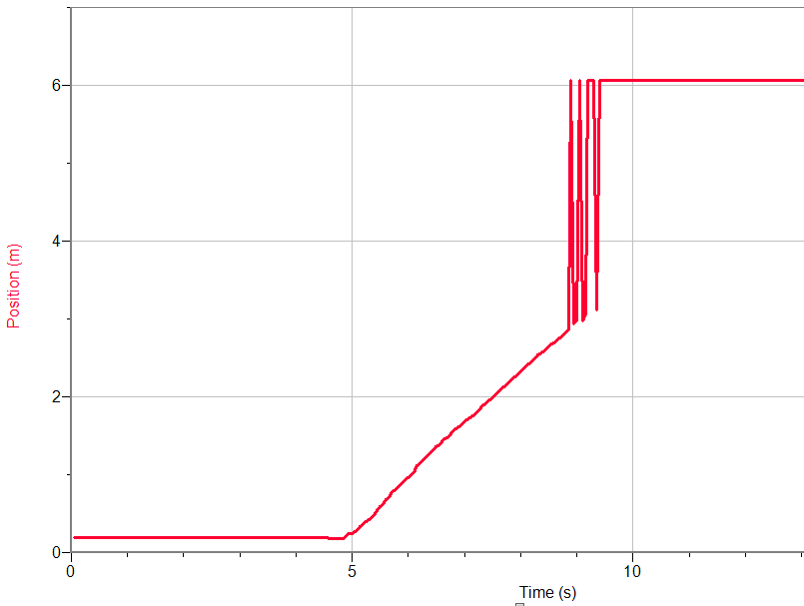
Position-time graphs
Trial 3
Watch the video here!
Notes:
The motion sensor seemed to lose the car after about 3m as you can see the position jumps to 6m which is the distance to the other end of the lab where testing occurred.

Slide 9
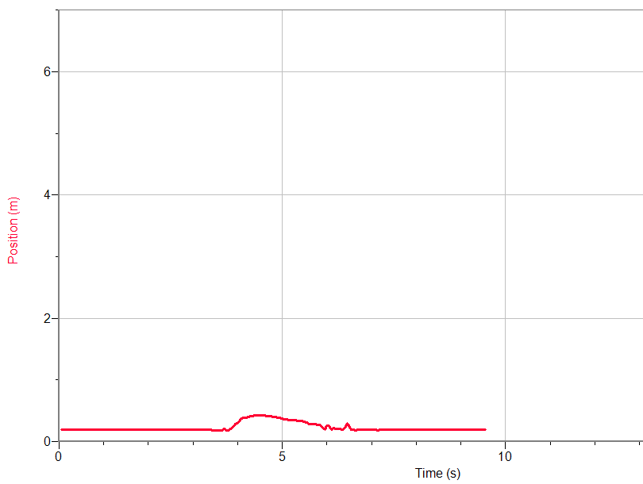
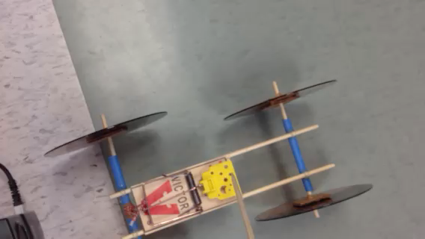
Trial 4
Trial 4
Position-time graph
Watch the video here!
Notes:
There was a lot of spinning and then I believe the string got stuck around the axle. Let’s watch the short video clip! I decided that more traction was a necessity and that a card of some kind should get added to the car to make it easier for the sensor to pick up.

Slide 10
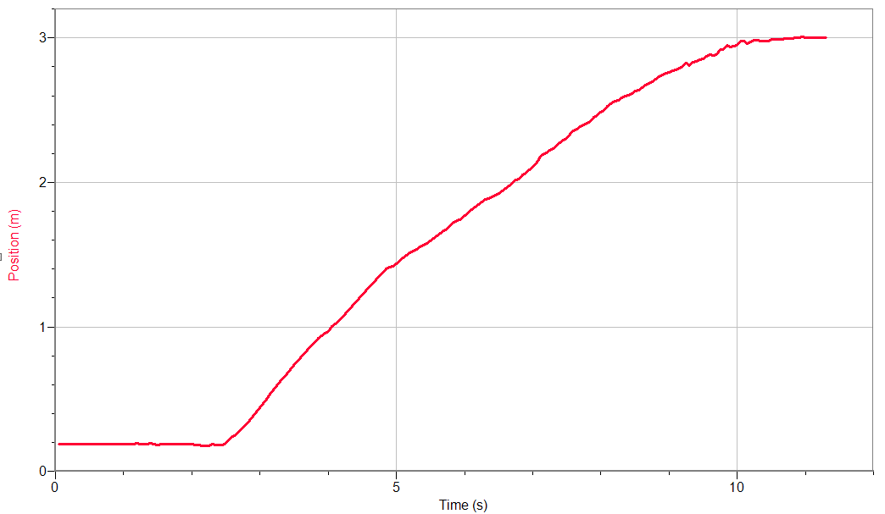
Position-time graphs
The average velocity decreased when the paper was added, but it was necessary for the motion sensor to keep track of the car.
Trial 5
Notes:
I added a piece of vertically oriented paper to the front of the car for this trial so that the car would remain visible to the motion sensor. I realized that this probably added considerable air friction and some mass to the car. I would have preferred adding some mass to the rear of the car, but there was no place to attach the paper. You can see from the graph that the average velocity is less than the early trials, which I determined was probably due to the added mass and air friction from the paper.

Slide 11
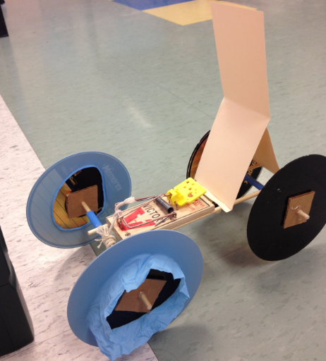
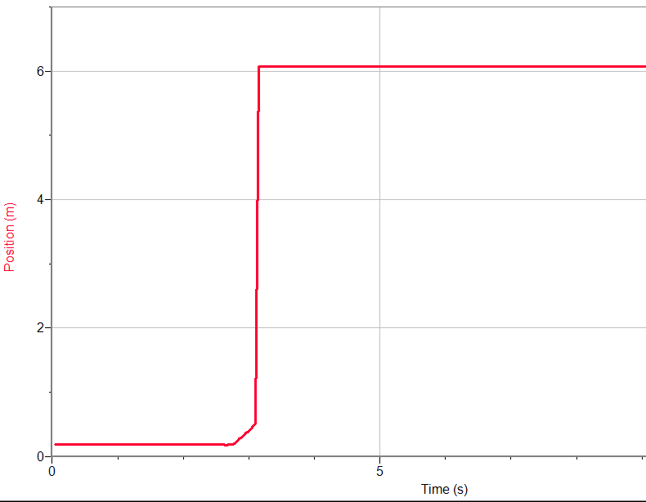
Rubber gloves for extra traction
Trial 6
Notes:
The rubber gloves added lots of traction and you can see from the position-time graph that there was considerable acceleration at the start. I noticed that after the car had more traction that it started really veering towards the left, hence the reason the motion sensor lost track of the car here, even with the paper card added.

Slide 12
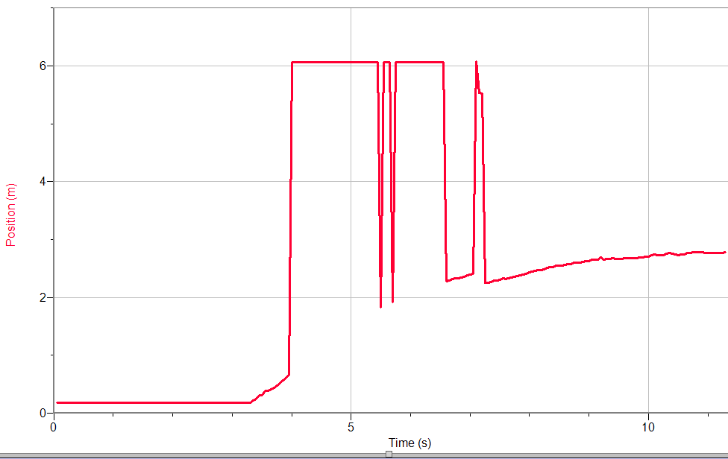
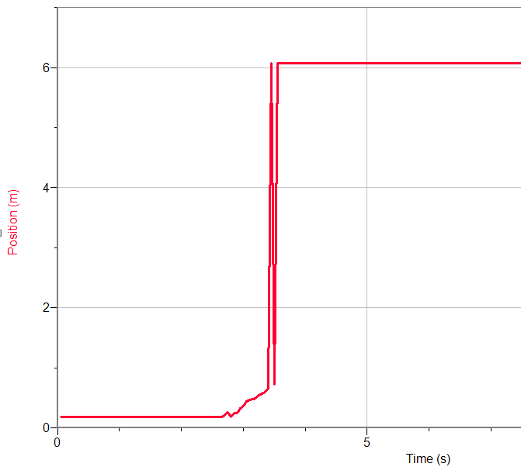
Position-time graphs
Trial 7
Trial 8
Notes:
Yet another discrepant event! It was puzzling me as to why the car was not travelling on a straight path. I couldn’t figure out what the problem was here after the paper and rubber gloves were both added. The string wasn’t catching anymore, but the car kept veering left and spinning out a bit. Perhaps there was too much acceleration.

Slide 13
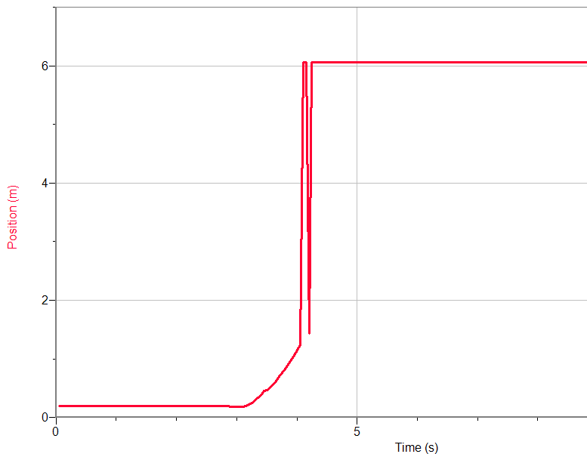
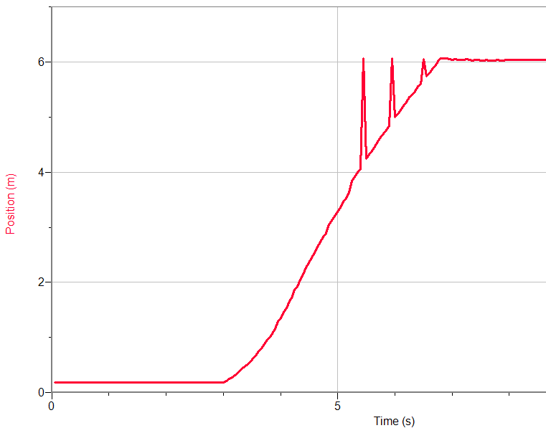
Aha! The left wheels were slipping on the axles.
Trial 9
Trial 10
Notes:
I hot glued a skewer which was 8cm long to one side of the mousetrap lever for Trial 9 through 12. I discovered during trial 9 the reason for the car veering left. The left wheels were not glued well and they were slipping on the axle where the cardboard was attached. I re-glued the left wheels and had my first successful run with trial 10. My cognitive disequilibrium had been balanced again. Persisting and solving this problem was very satisfying. I can see how students would feel a sense of accomplishment and pride in their cars once they have moved through any type of discrepant event. Once I had discovered the cause of the leftward veering, it made complete sense that the right wheels were the driving force, while the left wheels were just slipping.

Slide 14
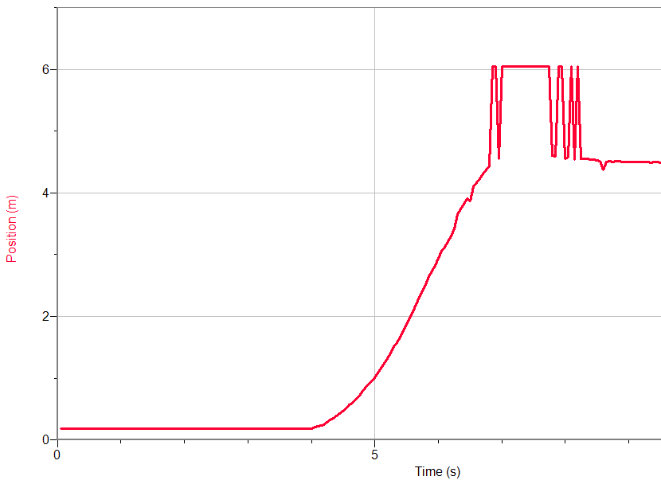
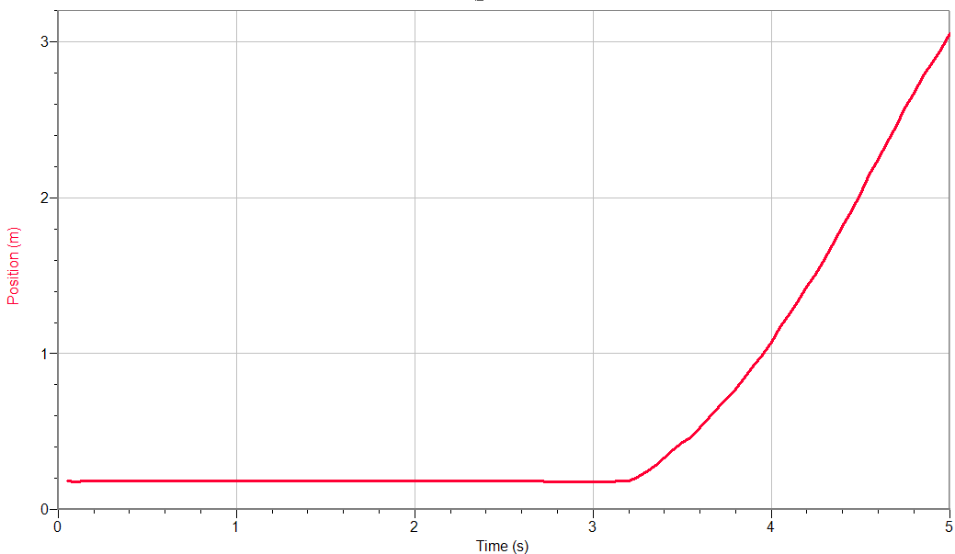
Position-time graphs
Trial 11
Trial 12
Notes:
I forgot to extend the collection time for trial 11, but this was a good run like trial 10! In trial 12 the string got stuck on the axle again so I cut a few more centimeters off of the end. The lever arm here was still 8cm.

Slide 15
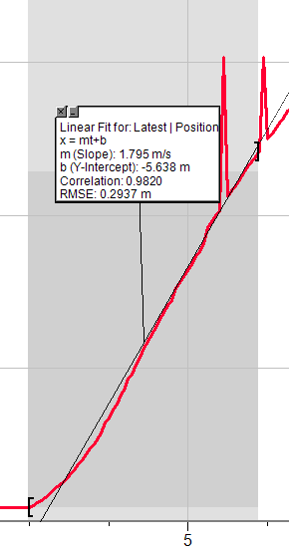
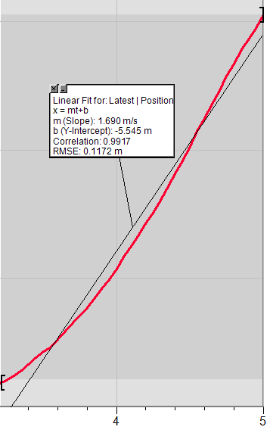
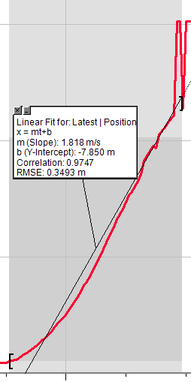
Average velocity for trials 10 through 12
Notes:
With a 1cm rear axle and a 8cm lever arm the average velocity for trials 10, 11 and 12 is 1.74m/s. I have removed trial 9 from the average since the car moved out of the range of the motion sensor.

Slide 16
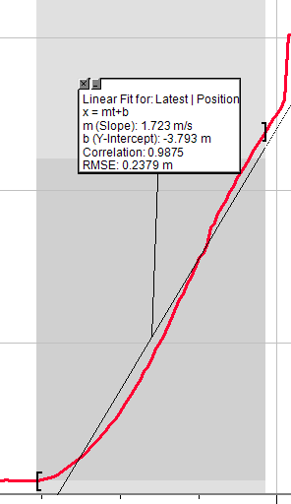
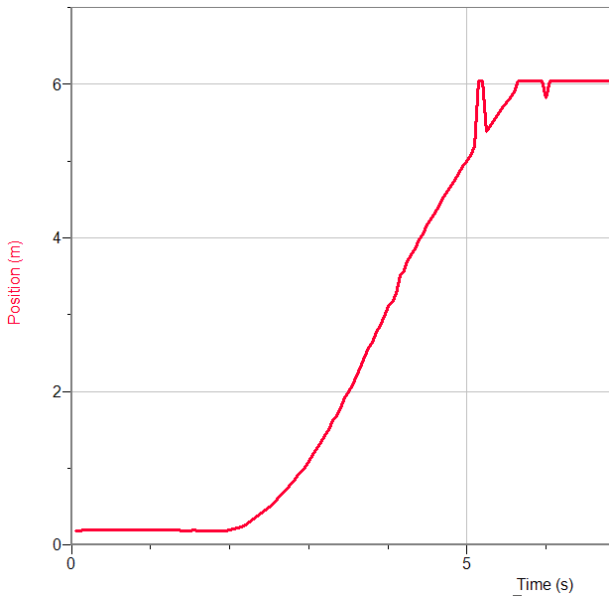
Trial 13
Position-time graph
Average velocity = 1.72m/s
Notes:
Trial 13 also had the same lever arm and axle as trials 10 through 12, and it confirms the average velocity found for the previous trials of 1.75m/s +/- 0.06.

Slide 17
Trials 10 to 13
The average velocity for trials 10 through 13 with a lever arm of 8cm was:
  Trial 10=1.795m/s
  Trial 11=1.690m/s
  Trial 12=1.818m/s
  Trial 13=1.723m/s
  Average= 1.75m/s +/-0.06

Slide 18
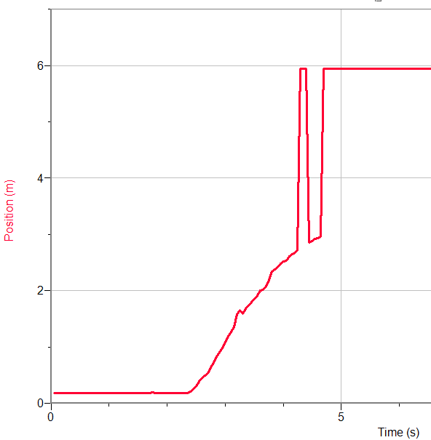
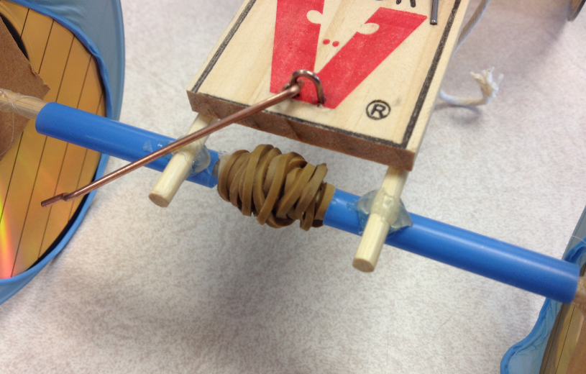
Trial 14
Position-time graph
Larger axle diameter
Notes:
I decided to try increasing the axle diameter for several trials since it was one of the tips to increase the speed of a mousetrap car. Wrapping a rubber band and gluing it to the axle, I had hoped that it would increase the diameter at the same time as increasing the friction between the string and the axle. The car had a much larger time for travelling 5m. I removed the rubber band and kept testing car A. This was the only trial with this modification as the rubber band was too close to the blue straws, and I determined that I would need to change the axle design a bit before I could perform trials where the axle size was increased.

Slide 19
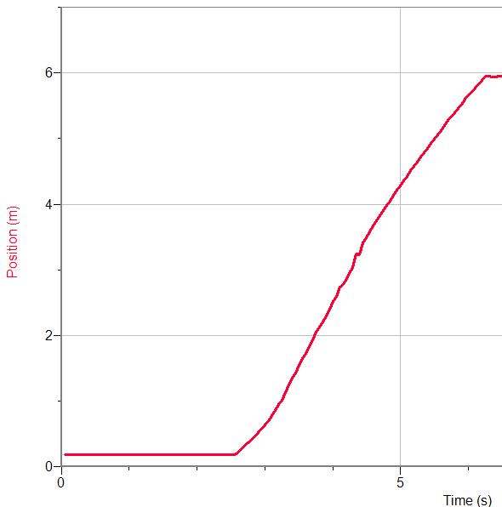
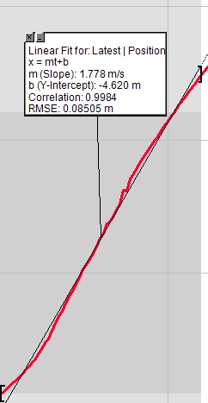
Trial 15 with 6.5cm lever arm
Position-time graph
Notes:
Since I could not investigate changing the axle diameter with this car, I decided to change the length of the lever arm to which the string was attached. For trials 15 to 20 the lever arm was decreased to 6.5cm.

Slide 20
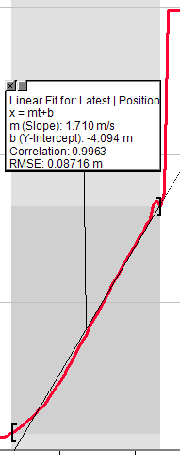
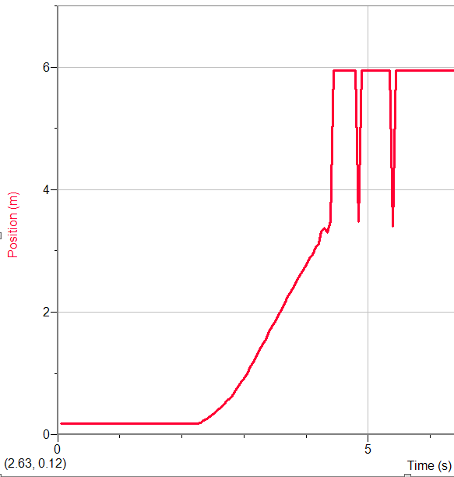
Trial 16 with 6.5cm lever arm
Position-time graph

Slide 21
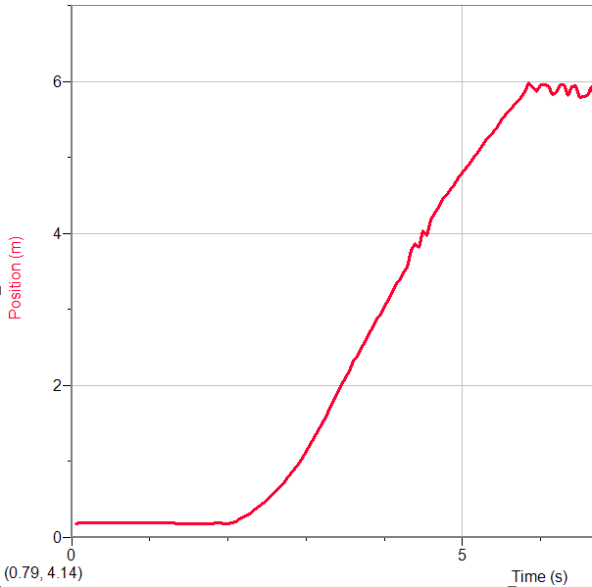
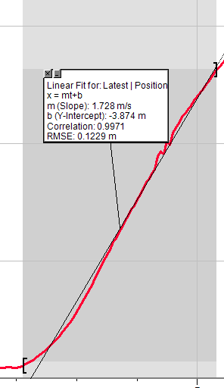
Trial 17 with 6.5cm lever arm
Position-time graph

Slide 22
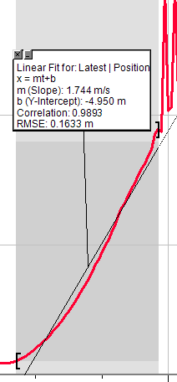
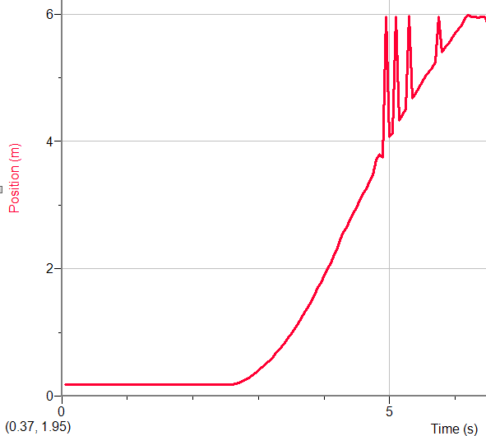
Trial 18 with 6.5cm lever arm
Position-time graph

Slide 23
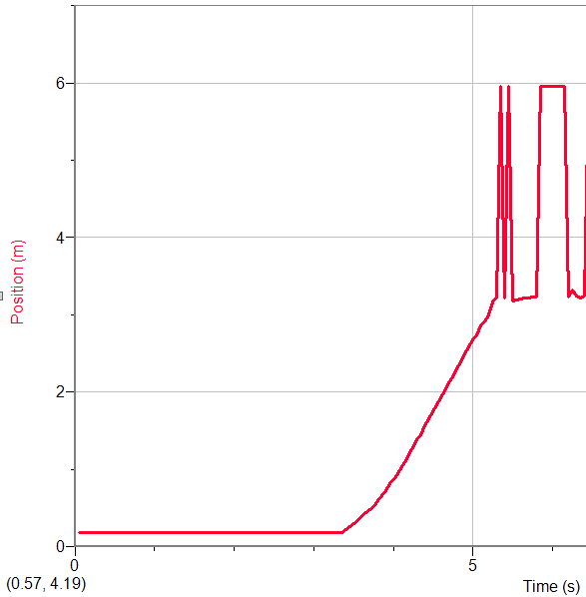
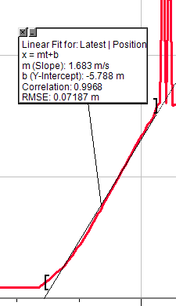
Trial 19 with 6.5cm lever arm
Position-time graph

Slide 24
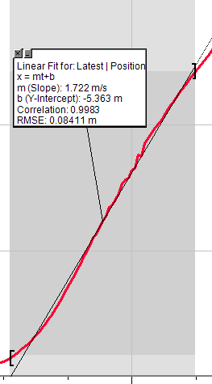
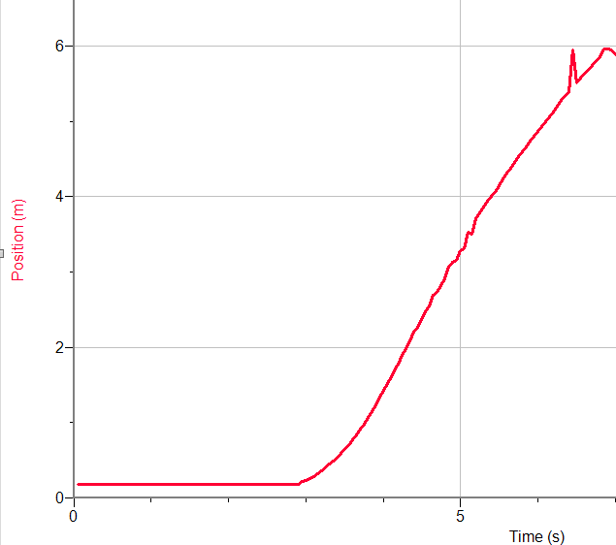
Trial 20 with 6.5cm lever arm
Position-time graph

Slide 25
Trials 15 to 20
The average velocity for trials 15 to 20 with a lever arm of 6.5cm was:
  Trial 15=1.778m/s
  Trial 16=1.71m/s
  Trial 17=1.728m/s
  Trial 18=1.744m/s
  Trial 19=1.683m/s
  Trial 20=1.722m/s
  Average= 1.73m/s +/-0.05
Notes:
Although decreasing the lever arm was a suggested modification, I found that decreasing the lever arm from 8cm to 6.5cm actually decreased the average velocity from 1.75m/s to 1.73m/s.

Slide 26
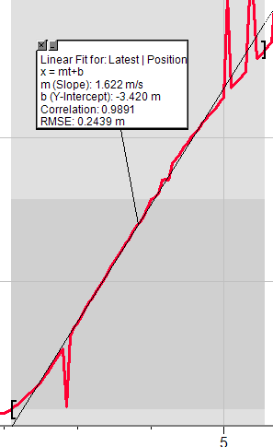
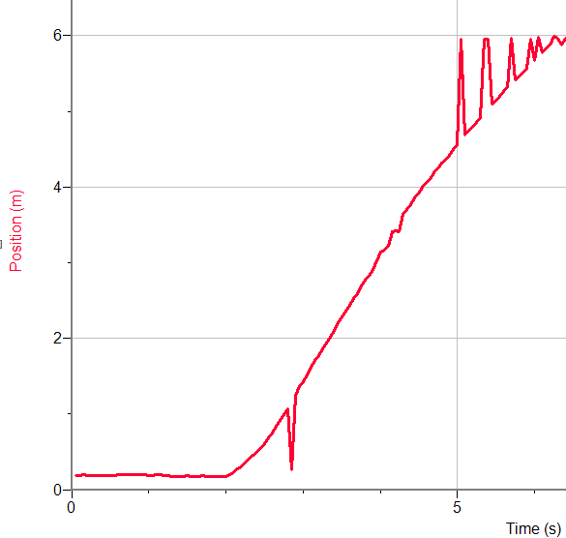
Trial 21 with 5cm lever arm
Position-time graph
Notes:
For trials 20 and 21 I further decreased the lever arm from 6.5cm to 5.0cm.

Slide 27
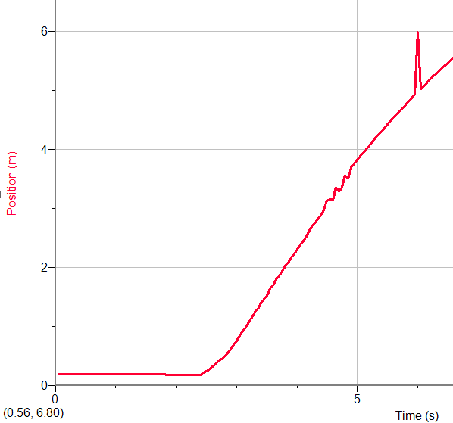
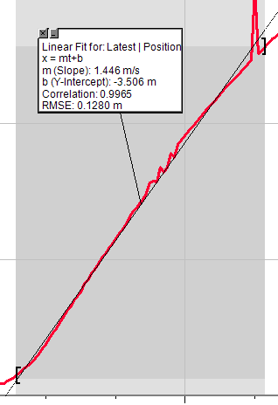
Trial 22 with 5cm lever arm
Position-time graph

Slide 28
Trials 20 and 21
The average velocity for trials 21 and 22 with a lever arm of 5cm was:
  Trial 21=1.622m/s
  Trial 22=1.466m/s
  Average=1.54m/s +/-0.07
Notes:
As the lever arm has decreased from 8cm to 6.5cm to 5cm the average velocity has decreased from 1.75m/s to 1.72m/s to 1.54m/s. Since trying a longer lever arm was not possible with this car I decided to start with a longer lever arm with the next car design.

Slide 29
Reflection on Car A
5E Learning Cycle
  Explore
  Explain
Meaningful learning
Misconceptions
Science and Engineering Practices
Notes:
I really consider my investigations with Car A to be my Explore and Explain parts of the 5E Learning Cycle. This time for students to collect data and to begin making sense of their data is so critical to them developing a scientific mind. By working to include class discussions regarding position-time graphs, velocity, acceleration, energy, torque, technology issues, controlling variables related to their cars, and challenging their explanations, meaningful learning is taking place. Students will learn important terminology and develop the language that is necessary to properly interpret their results.
The ending of the explore and explain phase is also a wonderful opportunity to work at revealing possible misconceptions related to the content before the class moves on to the Elaborate and Evaluate stages of the 5E Learning Cycle. Many students have misconceptions surrounding the relationships between position-time graphs and velocity-time graphs. For example, by having students commit to a velocity-time graph that matches a particular position-time graph you will expose and then confront their beliefs in these areas. Time needs to be given for them to them accommodate the concept or concepts before they move on with the project and further extend their understanding.
So far this project has hit on every Science and Engineering Practice; Asking questions & Defining problems, Developing and using models, Planning and carrying out investigations, Analyzing and interpreting data, Using mathematics and computational thinking, as well as Constructing explanations and designing solutions. By completing this power point presentation I am communicating my learning, but to have students engaging in argumentation surrounding their mouse trap cars either during the project or near its completion would hit the last two practices. For this reason, inquiry projects similar to this one should be woven into each and every science course being taught today.

Slide 30
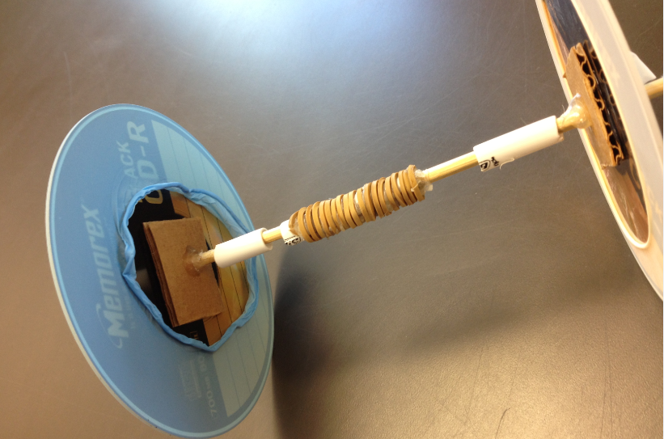
New axle designed for increased traction and less friction
Notes:
This is the new axle that allowed for a modification to the diameter of the axle using rubber bands. I left enough space on either side to eliminate friction between the axle and the white plastic attachments to the car body.

Slide 31
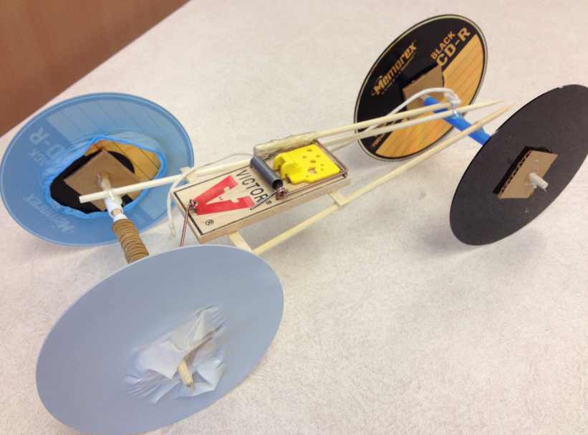
Car B with less overall mass
Notes:
This is my second car design. The wheels themselves are identical, but the rear axle has been modified so that I could make changes to the axle diameter. I also was able to use less massive balsa wood in the design. The longer starting lever arm should also be noted. A paper card similar to the one used for Car A was also added so that the car would be visible to the motion sensor.

Slide 32
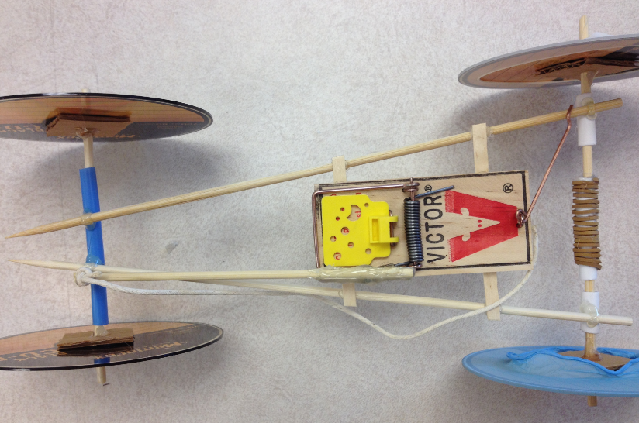
Overhead view of car B
Notes:
This overhead photo of car B allows you to see the longer starting lever arm of 15
cm.

Slide 33
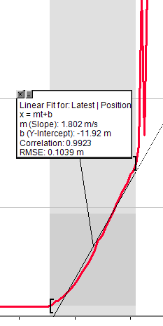
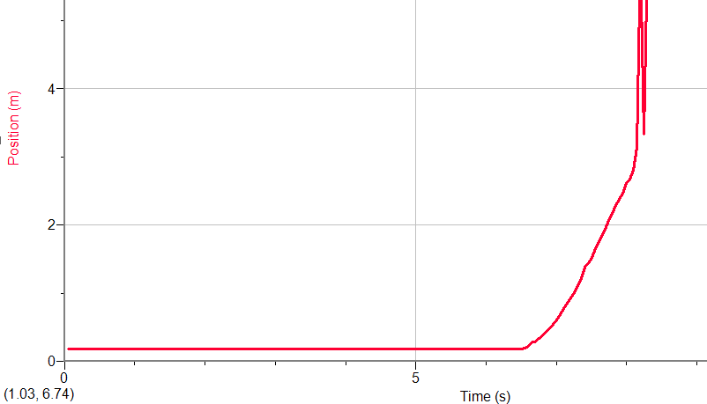
Trial 1B with 15cm lever arm
Position-time graph
Notes:
This trial with a 15cm lever arm and 1cm rear axle, veered left.

Slide 34
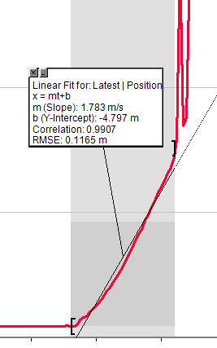
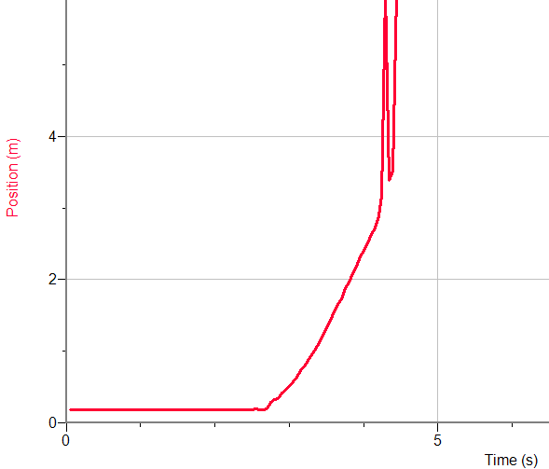
Trial 2B with 15cm lever arm
Position-time graph
Notes:
With this trial there was the same issue with the car veering left slightly and the motion sensor losing the car. I decided that a paper card had to be added.

Slide 35
Trial 1B and 2B
The average velocity for trials 1B and 2B was:
  Trial 1B=1.802m/s
  Trial 2B=1.783m/s
  Average velocity = 1.79m/s +/-0.01
Notes:
While the average velocity for trials 1B and 2B was high, the motion sensor was not able to track the car for the entire 5m distance.

Slide 36
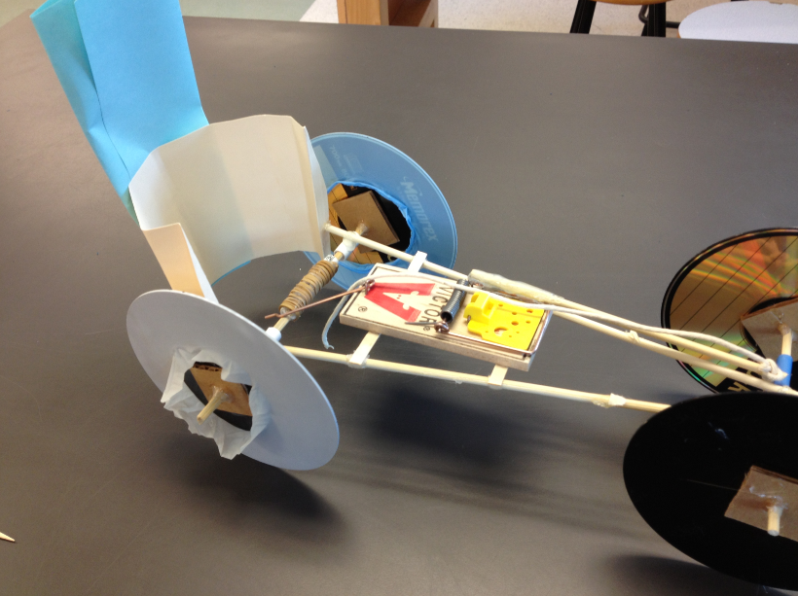
Car B with paper for motion sensor
Notes:
This photo shows Car B with the paper cards added for the motion sensor.

Slide 37
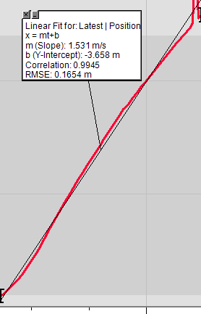
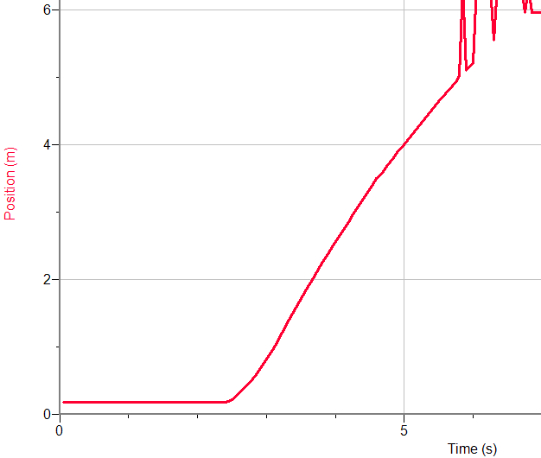
Trial 3B with 15cm lever arm
Position-time graph
Notes:
I added paper for the motion sensor and noticed how the curve changed, but the paper was necessary. 15cm lever arm, 1cm rear axle

Slide 38


Trial 4B with 15cm lever arm
Position-time graph
Notes:
15cm lever arm, 1cm rear axle,

Slide 39


Trial 5B with 15cm lever arm
Position-time graph
Notes:
15cm lever arm, 1cm rear axle

Slide 40

Trials 3B to 5B
The average velocity for car B with a 15cm lever arm were:
  Trial 3B=1.531m/s
  Trial 4B=1.614m/s
  Trial 5B=1.747m/s
  Average velocity=
  1.64m/s +/-0.11

Slide 41


Trial 6B with 12 cm lever arm
Position-time graph
Notes:
12cm lever arm, 1cm rear axle

Slide 42


Trial 7B with 12 cm lever arm
Position-time graph

Slide 43


Trial 8B with 12 cm lever arm
Position-time graph

Slide 44

Trials 6B to 8B
The average velocity for trials 6B, 7B and 8B with a lever arm of 12cm were:
  Trial 6B=1.682m/s
  Trial 7B=1.713m/s
  Trial 8B=1.646m/s
  Average velocity=
  1.68m/s +/-0.03
Notes:
The lever arm was decreased from 15cm to 12 cm and the average velocity increased from 1.64m/s to 1.68m/s.

Slide 45


Trial 9B with a 10cm lever arm
Position-time graph
Notes:
For trials 9B, 10B and 11B I decided to continue decreasing the lever arm to determine whether this trend of increasing velocity would continue.

Slide 46


Trial 10B with a 10cm lever arm
Position-time graph

Slide 47


Trial 11B with a 10cm lever arm
Position-time graph

Slide 48

Trials 9B to 11B
The average velocity for trials 9B, 10B and 11B with a 10cm lever arm was:
  Trial 9B=1.767m/s
  Trial 10B=1.766m/s
  Trial 11B=1.777m/s
  Average velocity=
  1.77m/s +/- 0.01
Notes:
Aha! The average velocity increased again!

Slide 49


Trial 12B with a 8.5cm lever arm
Position-time graph
Notes:
For trials 12B, 13B, and 14B I decreased the lever arm yet again, this time to 8.5cm.

Slide 50


Trial 13B with a 8.5cm lever arm
Position-time graph

Slide 51


Trial 14B with a 8.5cm lever arm
Position-time graph

Slide 52


Trial 15B with a 8.5cm lever arm
Position-time graph

Slide 53


Trial 16B with a 8.5cm lever arm
Position-time graph

Slide 54


Trial 17B with a 8.5cm lever arm
Position –time graph

Slide 55
Trials 12B to 17B
The average velocity for trials 12B through 17B with a 8.5cm lever arm was:
  Trial 12B=2.012m/s
  Trial 13B=2.057m/s
  Trial 14B=1.911m/s
  Trial 15B=1.966m/s
  Trial 16B=2.000m/s
  Trial 17B=1.895m/s
  Average velocity=1.98m/s +/-0.08
Notes:
Decreasing the lever arm to 8.5cm increased the average velocity even further to 1.98m/s.

Slide 56


Trial 18B with a 5.5cm lever arm
Position-time graph
Notes:
Once the lever arm was decreased to 5.5cm for trials 18B and 19B, the car did not have enough traction and most of the energy stored in the mouse trap was used up as the car spun out at the starting line. The average velocity for these two trials was very low because of the spinning.

Slide 57


Trial 19B with a 5.5cm lever arm
Position-time graph

Slide 58
Trials 20B and 21B
Despite attempts to increase traction the car continued to spin out mostly at the starting line.
Notes:
For trials 20B and 21B I tried increasing the amount of traction to prevent some of the spinning at the start. I tried putting additional rubber gloves on the rear wheels as well as the front wheels. I also tried adding a small amount of mass to the rear axle before moving on from Car B.

Slide 59

Car B with smaller front wheels
Notes:
My final trials included smaller front wheels on the same Car B. I also wanted to investigate changing the rear axle diameter. For trials 22B and 23B I left the rear axle at 1cm. Like Trials 18B to 21B there was a lot of spinning and energy lost.

Slide 60


Trial 24B with 3cm rear axle
Position-time graph
Avg. vel.=0.6861m/s
Notes:
For trials 24B, 25B and 26B I increased the diameter of the rear axle to 3.0cm using more rubber band and glue. The average velocity was quite low for all three trials due to the spinning from the starting line. Increasing the rear axle diameter would only be effective if there was a lot of traction. I determined that there was little I could do to further increase the traction other than changing the floor surface.

Slide 61


Trial 25B with 3cm rear axle
Position-time graph
Avg.vel.=0.6913m/s

Slide 62


Trial 26B with 3cm rear axle
Position-time graph
Avg.vel.=0.7416m/s

Slide 63


Trial 27B with rubber rear wheels
Position-time graph
Notes:
For the final trials I tried changing the front wheels to the back to see if the rubber wheels on the driving axle would give more traction and hence prevent the spinning at the starting line. You can see that the shape of the curves for these two trials is different from the three previous trials with the potential for an increased average velocity, however there was still too much spinning.

Slide 64


Trial 28B with rubber rear wheels
Position-time graph

Slide 65

Fastest run –Car B with 1cm rear axle and 8.5cm lever arm
Notes:
This is the video of my fastest run with an average velocity of 2.06m/s. If I were to continue with this project I would need to change the wheels so that there was adequate traction to test out the larger rear axle diameter. After some reflection, I have also realized that a larger average velocity could be realized with a different combination of axle diameter and lever arm distance. Perhaps with a longer lever arm, all the energy stored in the mouse trap would be released over a longer period of time and balance with the increased torque generated from the larger rear axle.

Slide 66
Reflection on Car B
5E Learning Cycle
  Elaborate
  Evaluate
Nature of Science
Science Process Skills
Notes:
Car B was really a good chance for me to elaborate on what I had learned with my investigation for Car A. I was able to apply the skills that I had learned with Car A, and although it was not a completely new situation, I was able to approach my investigation with Car B in a much more scientific way. I can see how this type of change midway through a project would require students to expand their understanding further while applying their skills in a slightly different situation. If students are asked to present their cars as well as their research to the class, there are opportunities for self-evaluation, peer-evaluation as well as teacher evaluation. The last two Science and Engineering Practices, Engaging in argument from evidence and Obtaining, evaluating and communicating information could also be met.
By doing projects such as this one with my classes, the nature of science will be at the core of the study of physics. With students working at their own investigations both in and outside of class time, they will hopefully see science as a more “creative endeavor”. A well designed project would serve as a vehicle to promote students building their science process skills such as organizational, creative, manipulative and communicative skills.

Slide 67
Reflection on becoming an
Inquiry Teacher
Five stages
  Forming an image of the ideal self. “What kind of teacher do I want to be three years from now?”
  Assessing your real self
  Planning a formal course of action
  Gaining new strategies and improving performance
  Finding a support system
Notes:
As I reflect on the course, everything we have worked on really resonates with my beliefs about the principal goals of science education. Over the past five years or so I have been restructuring my courses including demonstrations, activities and labs. Using a portfolio with my classes where all of their course work is formative until the end of the unit allows students the opportunities to reflect on their own learning, and then make changes or additions. Over this time I have been working away at the first four stages, however this course has opened my eyes to many ideas that will help me to become an effective inquiry teacher. The importance of questions and questioning techniques must be kept at the front of my mind.
Finding a support system for myself is something that is developing. My staff is very young with the average teacher in their first five years of teaching. There is only one teacher who is more experienced than me in my science department. This means that I will need to team up with a few other teachers in my department who are also interested in inquiry.
I am excited to continue on my journey to become the best teacher that I can be!

